Slide 1
MJ⁵
RC Delivery Aircraft
Mark Gabriel Samac, Jeffrey Denenberg, Jeff Bratman, Johnpierre Khachi, Justin Rector, Joseph Tuazon

Slide 2
Why RC Delivery Aircraft

Slide 3


A RC size delivery aircraft have many real life applications:
Joseph T.
Enables rapid delivery of critical supplies to remote environments.
Improves supply chain logistics by increasing short-range delivery capability.
Enhances delivery efficiency while lowering environmental impact.
Notes:
Enables rapid delivery of critical supplies such as food, medicine, and humanitarian aid to remote and urban environments.
Improves industrial and military logistics alike by augmenting resupply operations and extending logistical range.
Supports sustainability by reducing reliance on ground vehicles and minimizing fuel consumption.
Photo:
https://www.defense.gov/News/Feature-Stories/story/Article/1814289/humanitarian-operations-save-lives-build-goodwill/
https://amertranslogistics.com/blog/transport-logistics-whats-the-difference-between-transport-and-logistics/

Slide 4
Proposed Mission Operation & Requirements

Slide 5
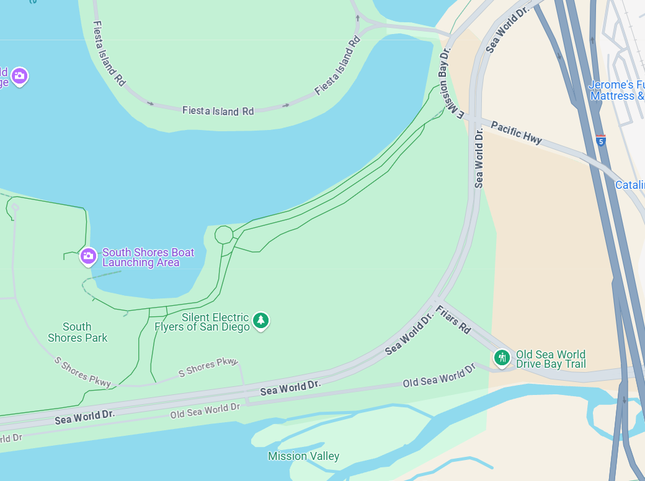
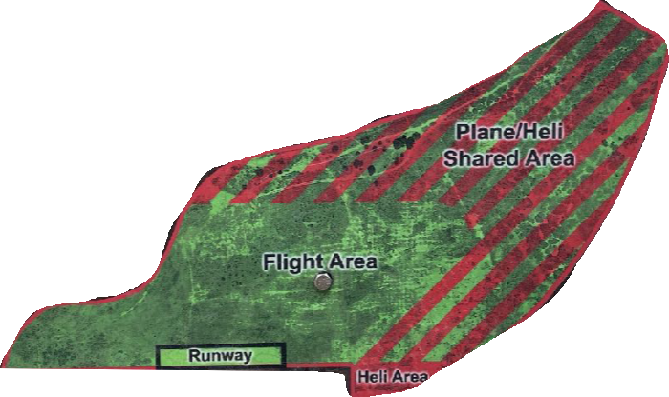
Our mission consists of flights with and without payload, and a package ejection
Joseph T.
Requirements and Constraints:
1 | The payload packages must consist of lead weights [P1] and an empty cardboard box [P2].
2 | The payload weight must be at least 0.5 lbs [P1] and volume at least 500 cm3 [P2].
x | Mission Bay Park atmospheric conditions are considered.
Mission Range of about 600 m
Notes:
done

Slide 6
Sizing/Scoring Function

Slide 7
Analyzing the scoring function requires simplification
Jeffrey D.
 | Assumption | Value
J gain per unit payload weight Wp | [fixed Vp of 500 cm³] | 7.50 $/lb
J gain per unit payload volume Vp | [fixed Wp of 0.5 lb] | 2.25 $/L
Assumptions:
L/D = ~8-13
Flight range: 600 m
η_{b} = 0.85
t_{flight} ∝ R/V_{cruise}
T_{cruise} ∝ D*W_{g}/L
P ∝ T_{cruise}*V_{cruise}
E_{flight} ∝ (P/η_{b})*(R/V_{cruise})
Conclusions:
Weight payload priority over volume payload
Cost of using energy is low
Cost of increased flight time is high

Slide 8
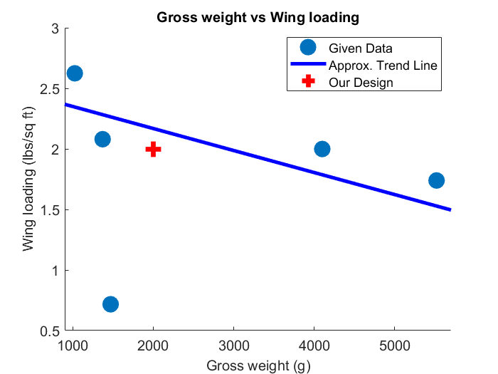
Several assumptions have been made, utilizing past built aircrafts
Jeffrey D.
From student-built aircrafts reference sizing values: [3]
Wing loading: ~2 lb/sq ft ~ 100 N/sq m
Cruise speed: ~20 m/s
Thrust-to-weight: ~0.8
Used to find:
Gross weight: ~2kg
Wing area: ~0.27 m
Notes:
This has to be where we show our assumptions: desired payload weight, setting payload volume constant, gross weight etc

Slide 9
Concept & Configuration

Slide 10
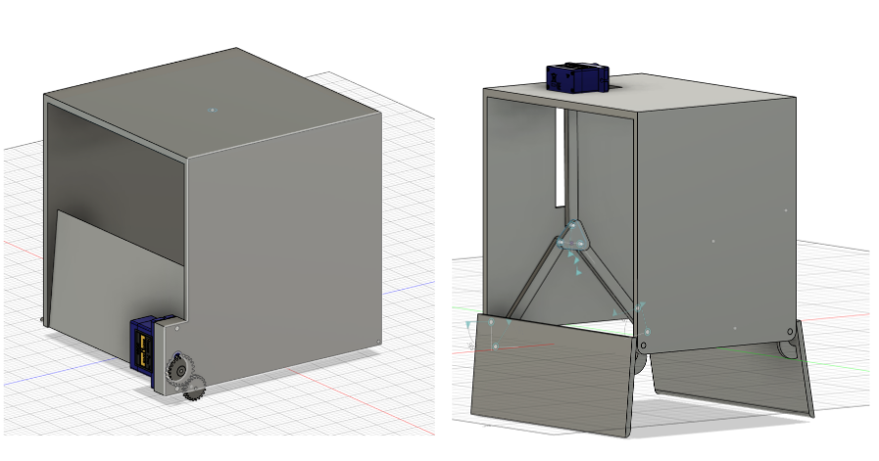
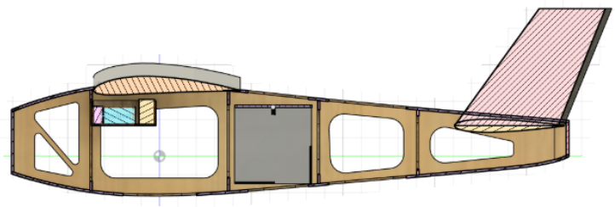
The fuselage structure includes hatch doors, strategized based on weight and durability
Johnpierre K.
The package drops-off in-flight through a hatch door mechanism
Two types are being considered at the moment
The inner fuselage design incorporates an optimal placement of electronics around the nose and a box-shaped space for payloads
The main wing and tails are to be anchored to the skeletal airframe
Two-door drop-off mechanism (two types)
Fuselage Structure with the payload (gray)
Notes:
done
Reduces aerodynamic interference (downwash effect) of the front wing on the rear wing.
Also, for dropping the package, the fuselage is closer to ground
Smaller wing aspect ratio.
Improve Maneuverability
Enhance stability
Coast_Efficency
Optimizing wing alignment improves lift and makes the flight more efficient.
Fuselage:
Designed for a 10 lb payload (2 packages) and electronics.
Wg ~55 lb
Wp = 10 lb
Balances strength, airflow, and weight distribution.
Landing Gear Design:
Adds padding under the body for safe landings.

Slide 11
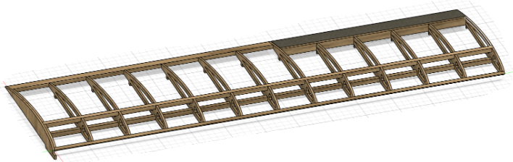
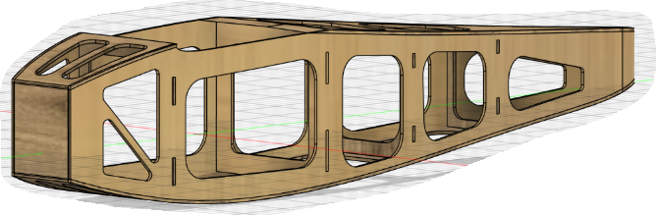
Wood-based fabrication is easy and low-cost with room for structural improvement
Johnpierre K.
The wing structure is to be constructed with wood
It boasts being lightweight and customizable (by rib/spar number) for wing loading
The fuselage structure is semi-monocoque with plywood skin
More internal frames can be added to maintain rigidity
Airframe structural integrity is heavily considered when removing excess material
Fuselage and Wing Structure Isometric View
Notes:
done

Slide 12
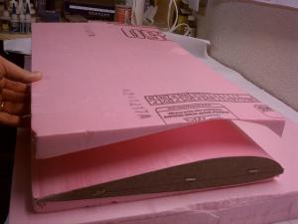
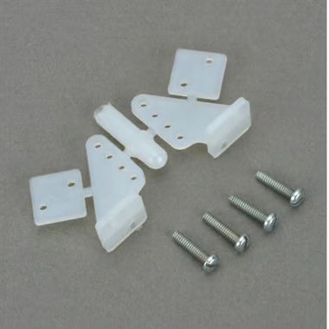
Other fabrication methods for control surfaces and smaller aircraft parts
Johnpierre K.
The control surfaces (ailerons, vertical and horizontal stabilizers) will be made from foam; an easier fabrication due to size
Ailerons: Hinged to wing trailing edge (tape/pin hinges)
Stabilizers: Reinforced with carbon fiber tubes; Glued to fuselage or tail boom
Nacelle, trim tabs, spinner, control horns and other small parts will be 3D printed
Attached to front plywood bulkhead either using bolts or embedded magnets
3D printed for precise aerodynamic shape and internal mounts
Attached to front plywood bulkhead using bolts or embedded magnets for easy removal
Notes:
done

Slide 13
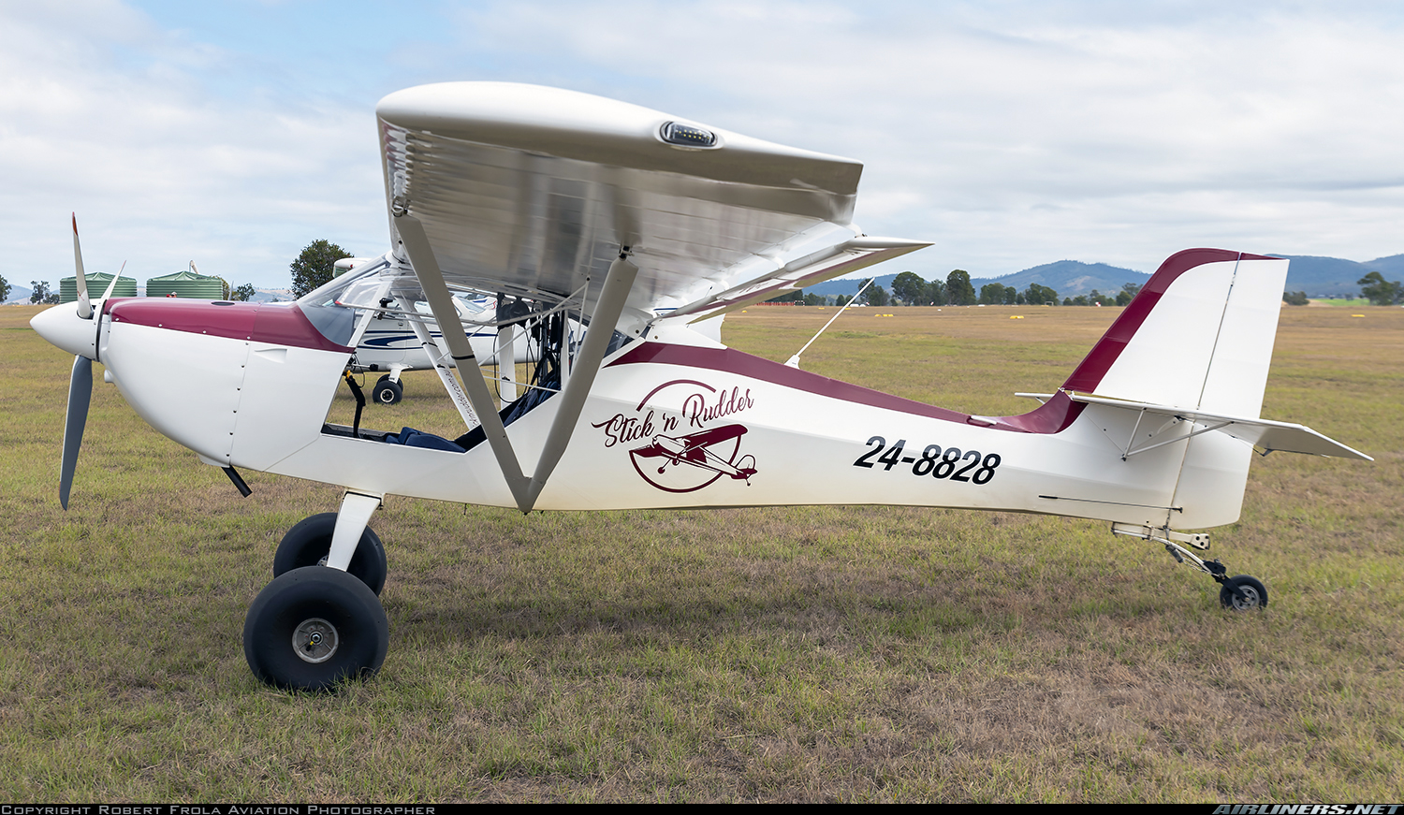
A taildragger landing gear setup to provide better takeoff performance
Johnpierre K.
The landing gear will be a taildragger, with two main wheels in front of CG and a wheel at the end (tail)
An inclined aircraft means higher wing angle-of-attack, effectively generating better takeoff lift
Increased ground clearance protects propeller and fuselage during rough-field operations
Rudder and tailwheel control are merged for simplicity and to reduce overall system weight
Example of tail dragger [2]
Notes:
done

Slide 14
Aerodynamics

Slide 15
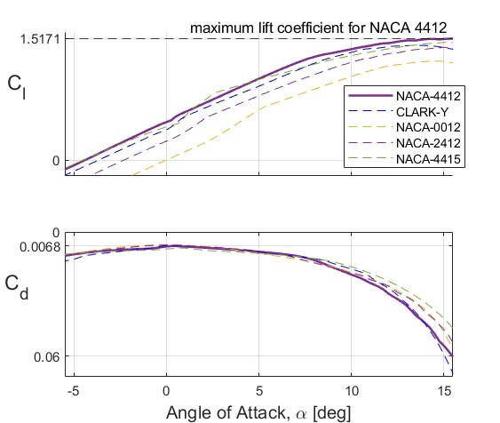
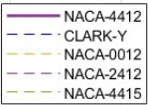
NACA 4412 selected — excels in providing the best lift among candidates
Mark S.
Based on the flight area’s atmospheric conditions, 25 m/s cruise speed, and a 0.2 m chord length, the Reynold’s number, Re, is around 340,000.
But, XFOIL airfoil data for Re = 500,000 was used and assumed
Drag is identical, therefore, airfoil selection was based on lift.
Notes:
done

Slide 16
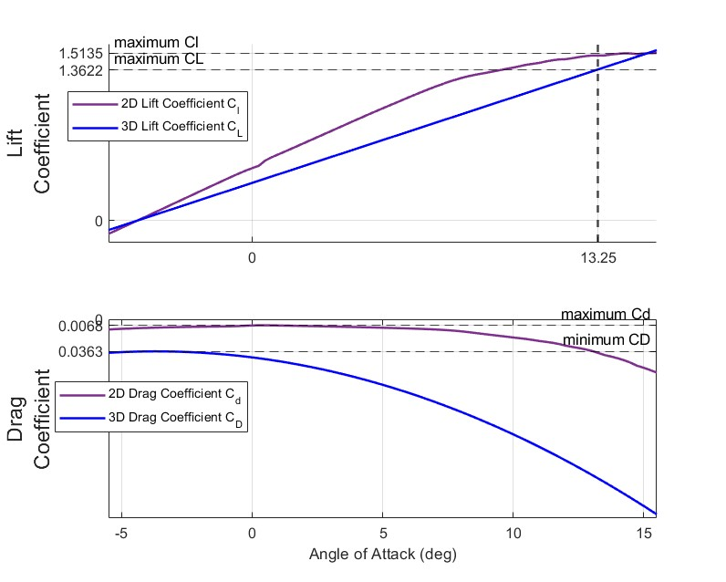
3D aerodynamics retrieved from 2D data and some sizing assumptions
Mark S.
Here, the lift and drag coefficients consider all parts of the aircraft not only the wing
The drag build ups for the motor and landing gear are fixed
Stabilizers are ideally sized, so changes can be made to reduce drag

Slide 17
Thus, tail sizing will determine the future drag build up, and aircraft overall performance
Mark S.
Major Aerodynamic Parameters & Values |  |  | Main Wing Dimensions
CL,max | 1.3622 |  | Planform Area | 0.27 m²
CD,min | 0.0363 |  | Wing Span | 1.35 m
(L/D),max | 35.838 |  | Chord | 0.2 m
S_{wet}/S_{ref} | 2.0480 |  | Aspect Ratio | 6.75
AOA (max L/D) | 13.25° |  | Sweep | 0
CD₀ | 0.035 |  | Taper Ratio | 1

Slide 18
Performance

Slide 19
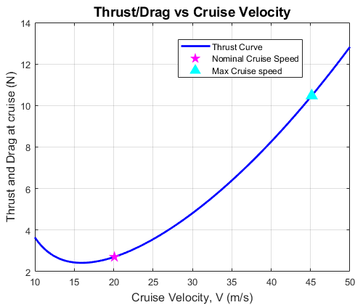
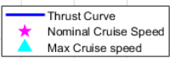
At steady-level flight:
Justin R.
Nominal Cruise speed of 20 m/s requires roughly 30% of max thrust
The maximum Cruise speed at max thrust of 10 N is roughly around 44 m/s
Notes:
done

Slide 20
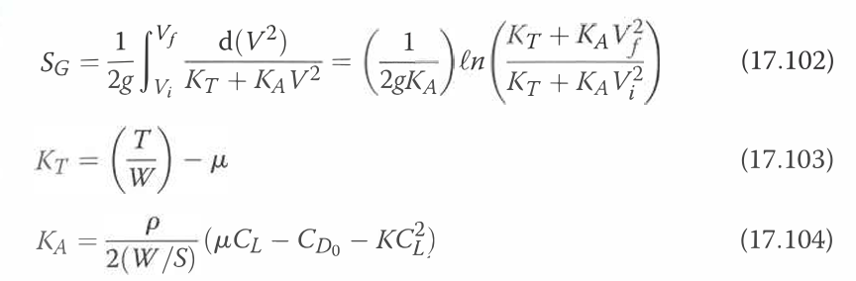
An overall takeoff distance of 12.26m at 70% takeoff speed
Justin R.
Main Parameters/Conditions | Value
Stall Speed | 9.314 m/s
Wing loading | 100 N/m^2
μ (Runway) | 0.03
T/W | 0.5
Takeoff Distance | 12.26 m
Ground roll distance equations from [1] Raymer 2018
Notes:
done

Slide 21
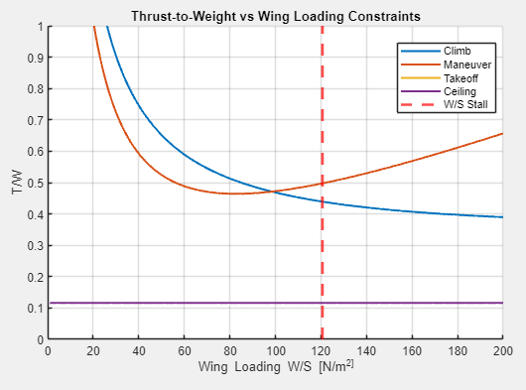
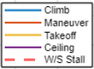
Agile performance at Climb and Maneuver
Justin R.
Main Parameters/Conditions | Value
n (Load Factor) | 4
𝜸 (Climb Angle) | 15 deg
Notes:
done

Slide 22
Propulsion

Slide 23
Main Constraints for Propeller Selection
Jeff B.
The motor is fixed Cobra C-2217/16 Brushless Kv = 1180
Assumed operating range of 50-80% of maximum (~13100 RPM) at cruise, which is 6500 - 10500 RPM
3 N minimum thrust, from performance, needed to maintain nominal cruise speed.
Notes:
done

Slide 24
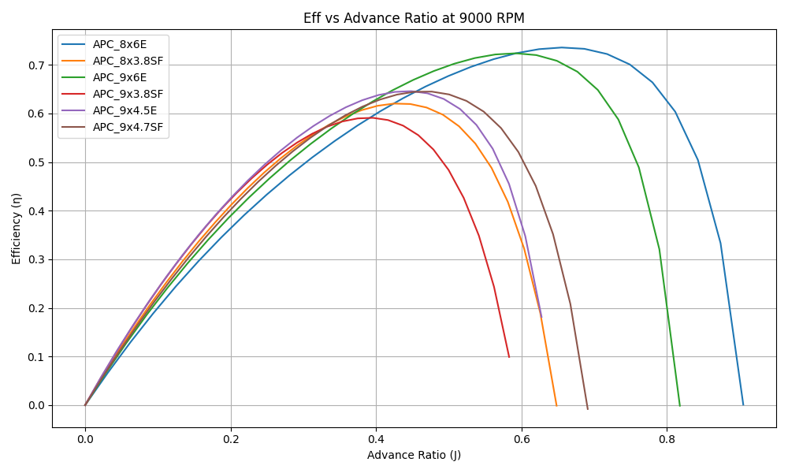
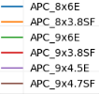
Initial tests revealed 9x6E and 8x6E were most promising candidates
Jeff B.
Notes:
done

Slide 25
The 9x6E best meets the propulsion requirements
Jeff B.
Propeller | ƞ | Thrust [N] | Torque [Nm] | Power [W] | Advance ratio [J] | n [RPM]
9x6E | 0.724 | 3.75 | .112 | 105.29 | 0.583 | 9000
8x6E | 0.736 | 2.66 | 0.077 | 72.20 | 0.655 | 9000
8x6E propeller demonstrated the highest efficiency
But, it fails to meet required 3 N of thrust at 9000RPM
9x6E produces 3.75 N at slightly less efficiency
Notes:
done

Slide 26
Structures and Weights

Slide 27
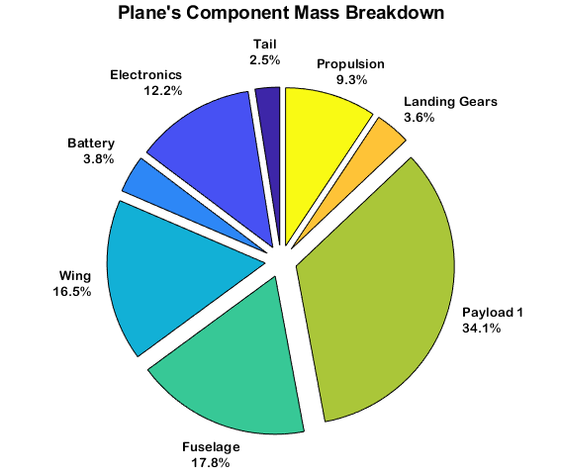
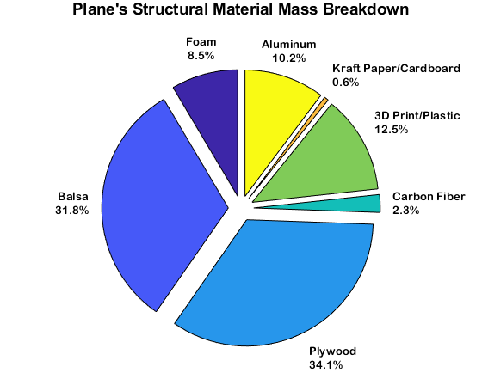
The initial weight breakdown shows aircraft being 2/3s wood and largely Payload 1
Justin R.
Total Gross
Weight: 2 kg
Heaviest is Payload 1 followed by Fuselage and Wing
2/3’s Wood (Balsa & Plywood)
Notes:
done

Slide 28
The tail sizing needed for stable flight
Justin R.
Initial Parameters | Value
Horizontal Tail Volume Coefficient | 0.35
Vertical Tail Volume Coefficient | 0.04
Lever arm (Horizontal Tail) | 0.42 m
Lever arm (Vertical Tail) | 0.42 m
Design Parameters | Value
Planform Area (HT) | 0.045 sq m
Planform Area (VT) | 0.0347 sq m
Notes:
done

Slide 29
The aircraft is stable in all 3 configurations
Justin R.
Parameter | % from MAC
Neutral Point | 58
CG (Empty Flight) | 24.73
CG (with Payloads 1 & 2) | 24.05
CG (with Payload 1) | 23.97
Static Margin | 17%
Very stable flight due to static margin
CG is slightly forward of quarter chord
Room for later changes
Notes:
done

Slide 30
Future Improvements

Slide 31
Preparations and Plan for the FDR
Joseph T.
Revise and refine 3D aerodynamic and stability analysis with our final aircraft design.
Prototype and test the payload drop-off mechanisms for reliability and control.
Explore integration of foam/carbon fiber materials for control surfaces and tail.
Notes:
done

Slide 32
References
[1] - Raymer, Daniel P. Aircraft Design: A Conceptual Approach: A Conceptual Approach. 6th
ed., American Institute of Aeronautics and Astronautics Inc, 2018.
[2] - https://www.airliners.net/photo/Stick-n-Rudder/Aeropro-Eurofox-2K-Taildragger/6372355
[3] - Hwang. J. Lecture 01 - Introduction. MAE 155B. University of California San Diego

Slide 33
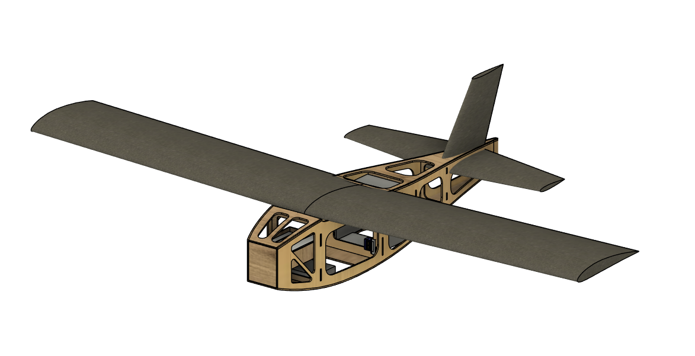
Questions?

Slide 34
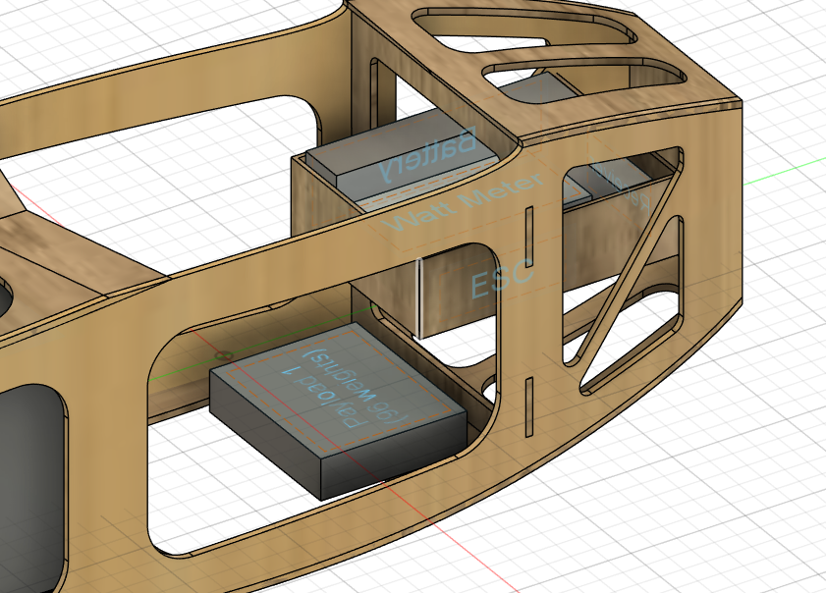
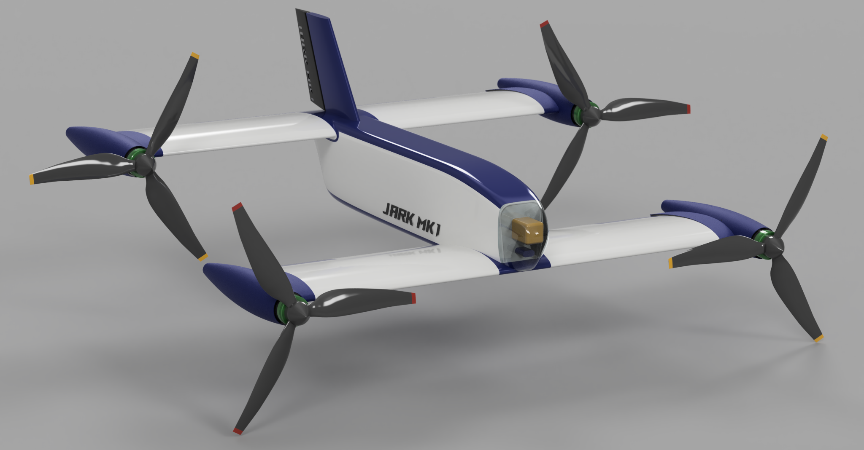
Thank you!

